Slide 1
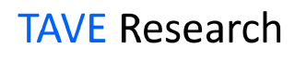
Autoencoder and GAN
Hands-On Machine Learning Part2
- Chapter 17 -
TAVE Research DL001
Heeji Won

Slide 2
Contents
01. Overview
02. Autoencoder
03. GAN

Slide 3
Contents
01. Overview
02. Autoencoder
03. GAN

Slide 4
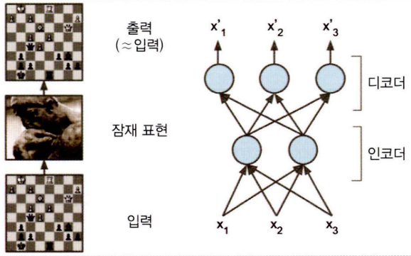
01. Overview
Autoencoder and GAN are unsupervised learning technique and learn useful representation
But, they work differently
▶ Autoencoder
Learns to copy its input to its output
are restricted in ways that force then to reconstruct the input approximately, preserving only the most relevant aspects of data
A autoencoder consists of two parts, the encoder and the decoder
Get to know how to represent data effectively
▶ GAN
Train by two networks (generative network, discriminative network) contesting with each other in a zero-sum game (adversarial training)

Slide 5
Contents
01. Overview
02. Autoencoder
03. GAN

Slide 6
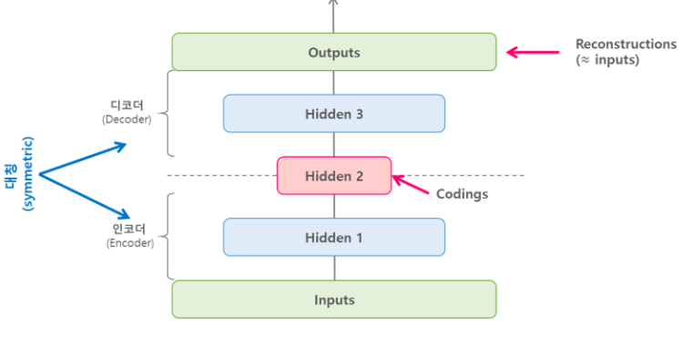
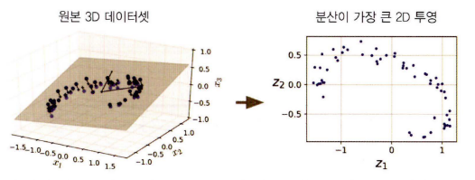
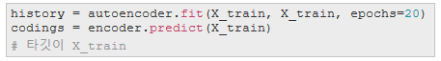
02. Autoencoder
Stacked autoencoder
A stacked autoencoder is a neural network consist several hidden layers
Can be used for pre-trained model
Undercomplete autoencoder
Undercomplete means the feature space have lower dimensionality than the input space
If autoencoder use only linear activation and MSE as cost function, it is the same as PCA
Be careful not to be Over-fitting

Slide 7
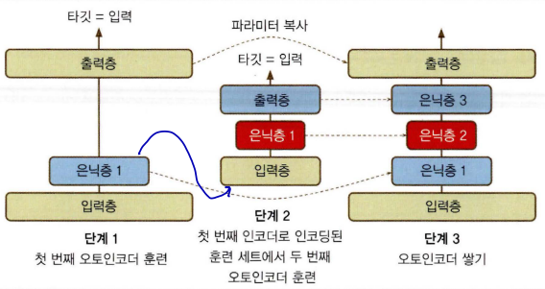
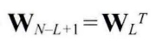
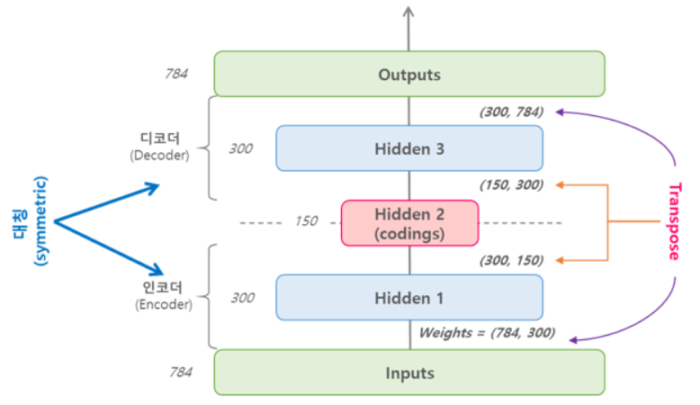
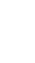
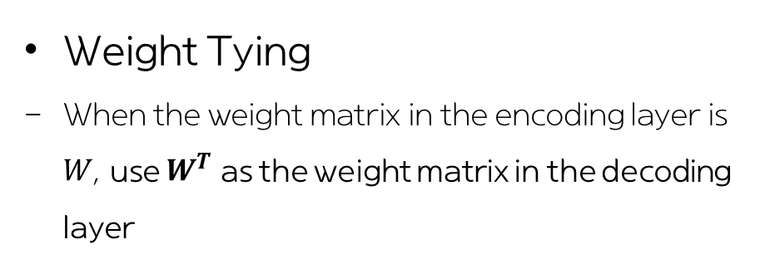
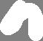
02. Autoencoder
Greedy layer-wise training
(not used very well these days)
Undercomplete autoencoder
Weight Tying
When the weight matrix in the encoding layer is $W$, use $W^{T}$ as the weight matrix in the decoding layer
Recurrent autoencoder
Regard each row as a sequence
Encoder is a Sequence-to-Vector RNN and decoder is a Vector-to-Sequence RNN

Slide 8
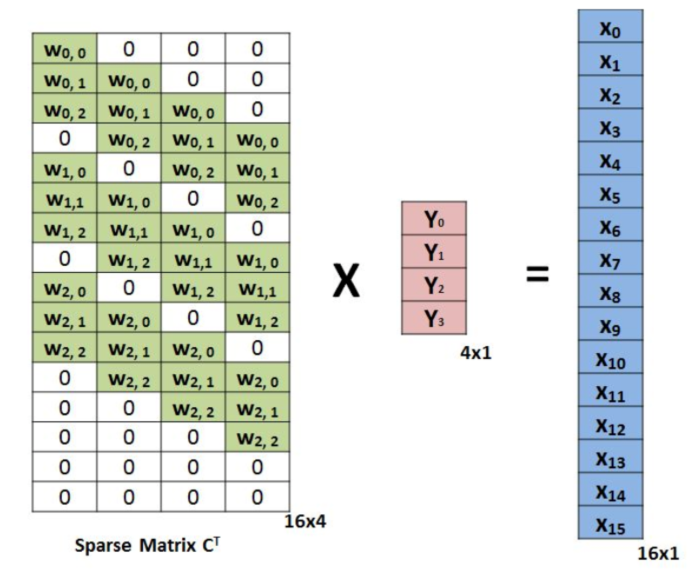
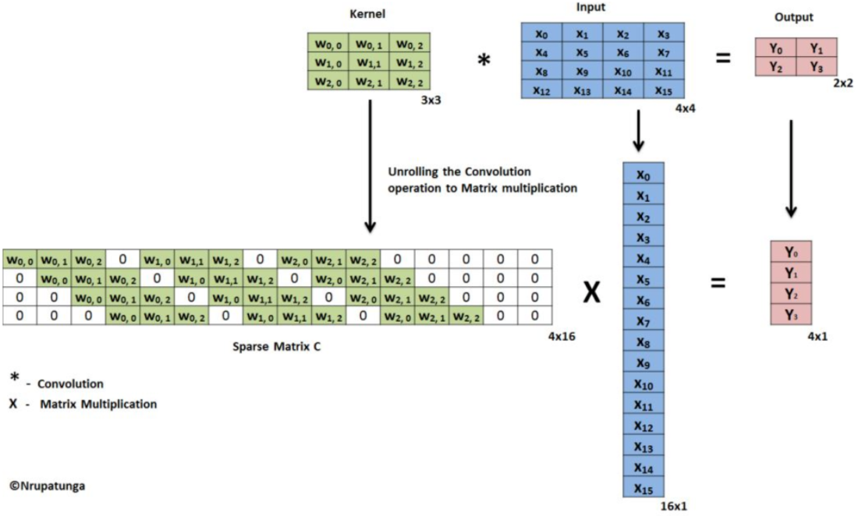
02. Autoencoder
Undercomplete autoencoder
Convolutional autoencoder
Consists of convolution layers and pooling layers
Encoder reduce spatial-wise dimension (i.e. height and width) and increase depth (i.e. the number of feature maps)

Slide 9
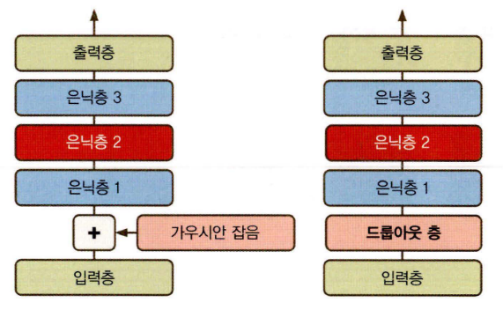
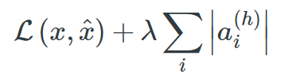
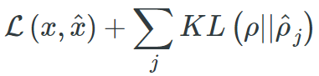
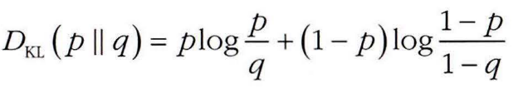
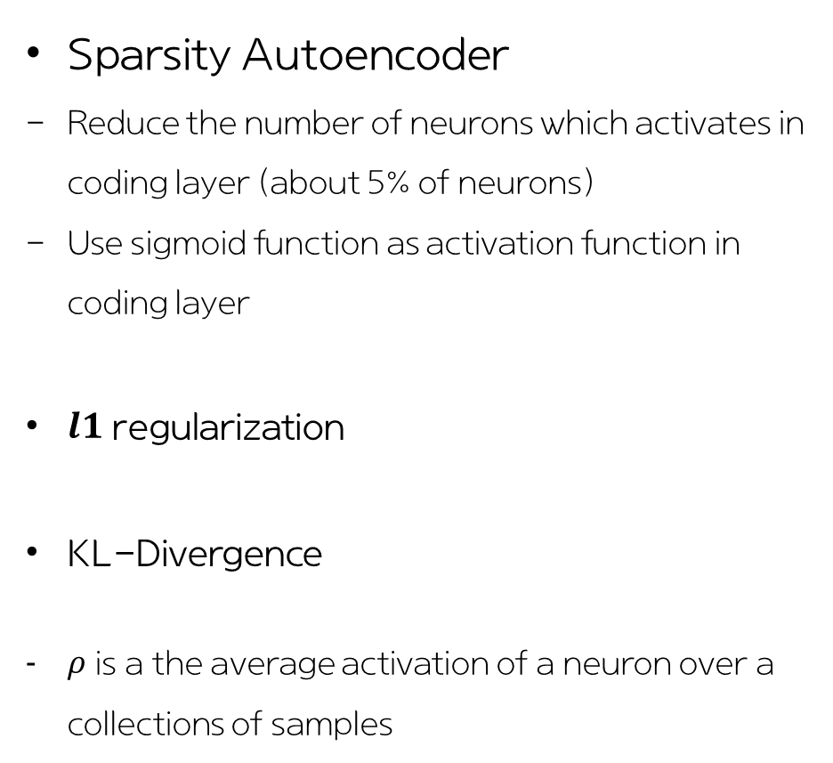
02. Autoencoder
Sparsity Autoencoder
Reduce the number of neurons which activates in coding layer (about 5% of neurons)
Use sigmoid function as activation function in coding layer
$l1$ regularization
KL-Divergence
$ρ$ is a the average activation of a neuron over a collections of samples
Overcomplete autoencoder
Stacked denoising autoencoder
For data visualization
For pre-trained model
For eliminating noise

Slide 10
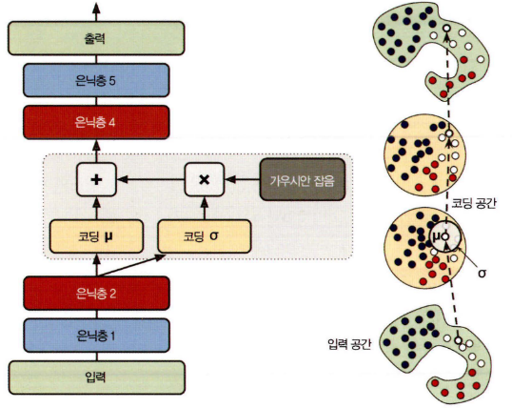
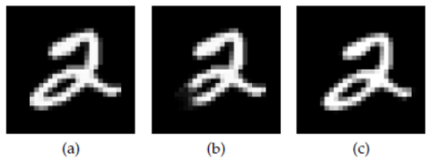
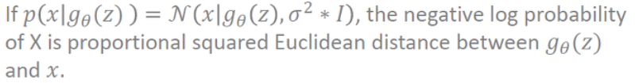
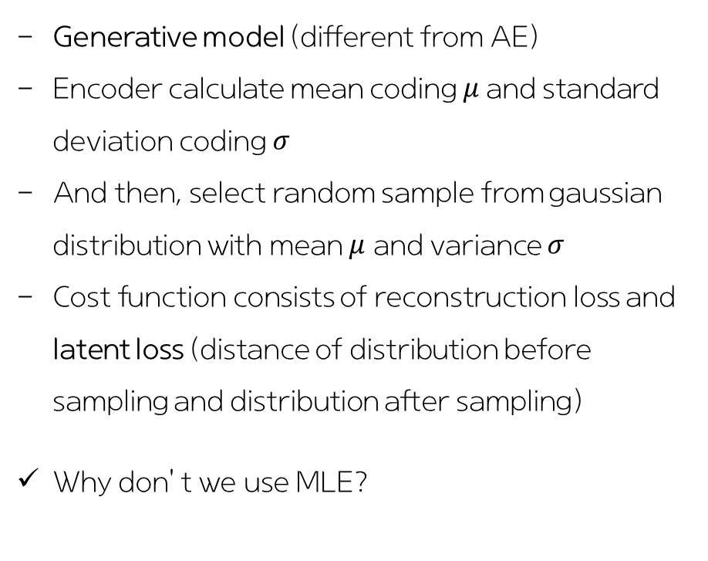
02. Autoencoder
Variational autoencoder (VAE)
Generative model (different from AE)
Encoder calculate mean coding $μ$and standard deviation coding $σ$
And then, select random sample from gaussian distribution with mean $μ$ and variance $σ$
Cost function consists of reconstruction loss and latent loss (distance of distribution before sampling and distribution after sampling)
Why don’t we use MLE?

Slide 11
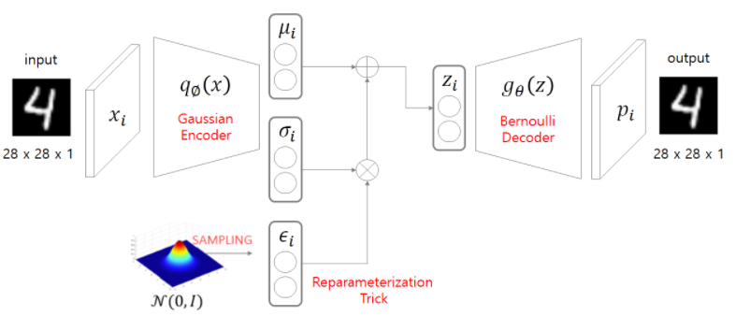
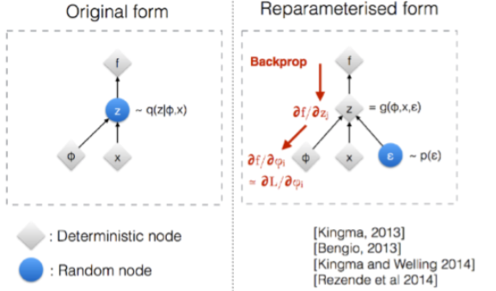
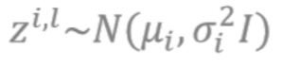
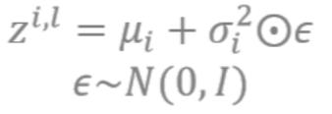
02. Autoencoder
Variational autoencoder (VAE)
Same distribution!
But it makes backpropagation possible!!

Slide 12
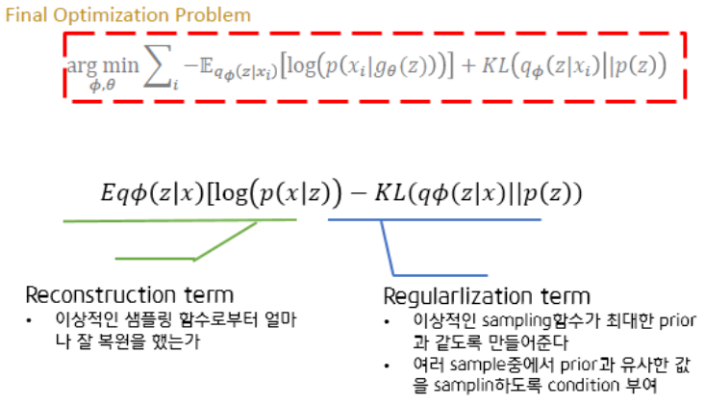
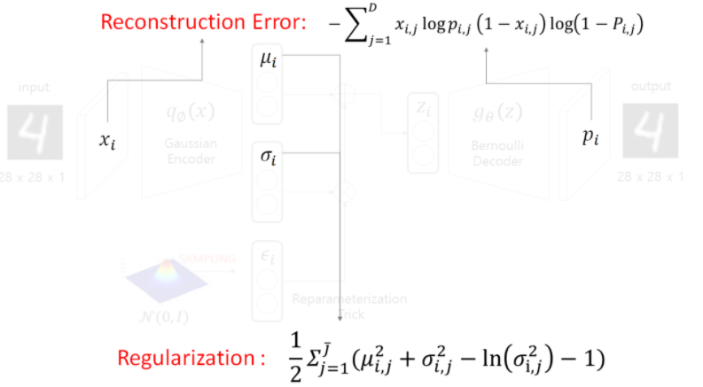
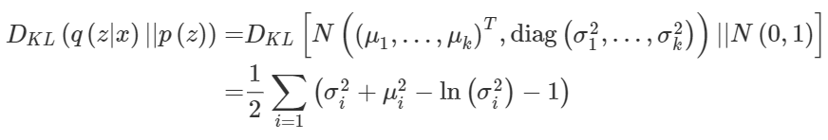
02. Autoencoder
Variational autoencoder (VAE)
ELBO

Slide 13
Contents
01. Overview
02. Autoencoder
03. GAN

Slide 14
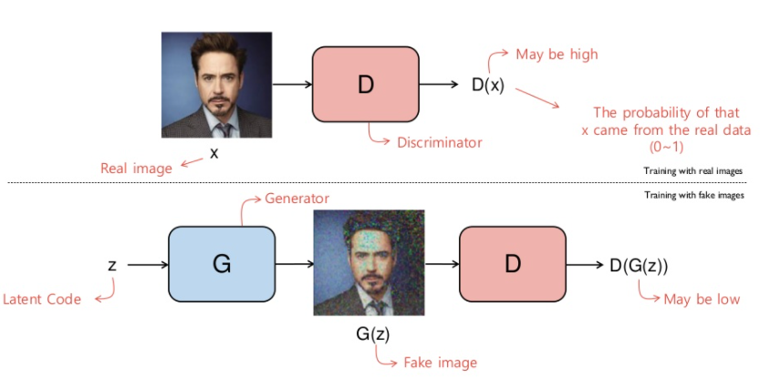
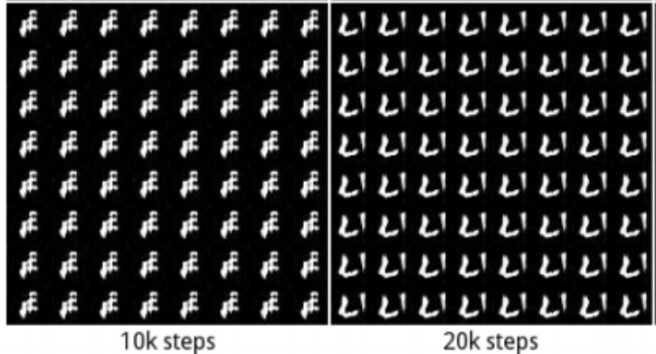
03. GAN
Training by two networks (generative network, discriminative network) contesting with each other in a zero-sum game (adversarial training)
Process
Difficulty
Unstable parameters
Mode collapse when reduced diversity of the generator’s output
Toward Nash equilibrium...
Mode collapse

Slide 15
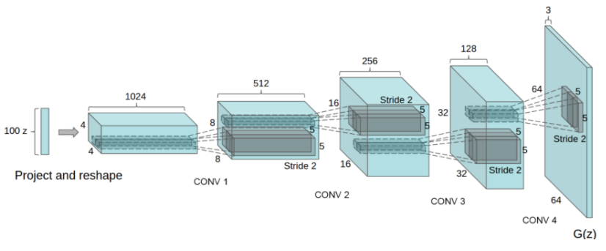
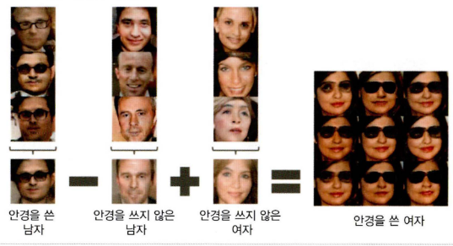
03. GAN
Deep convolutional GAN (DCGAN)
Replace all max pooling with convolutional stride
Use transposed convolution for upsampling.
Eliminate fully connected layers.
Use Batch normalization except the output layer for the generator and the input layer of the discriminator.
Use ReLU in the generator except for the output which uses tanh.
Use LeakyReLU in the discriminator.
latent vector arithmetic

Slide 16
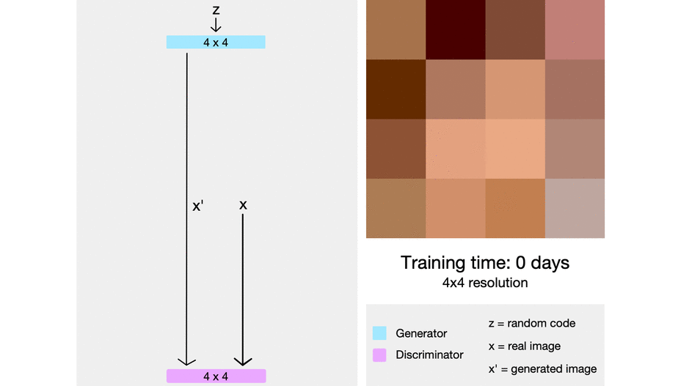
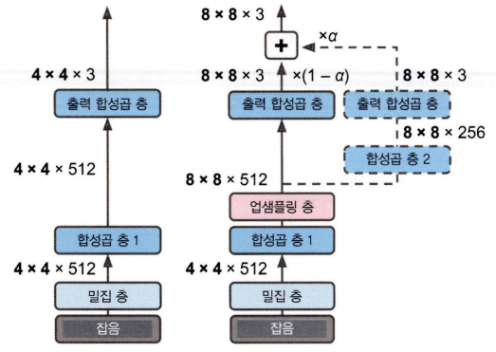
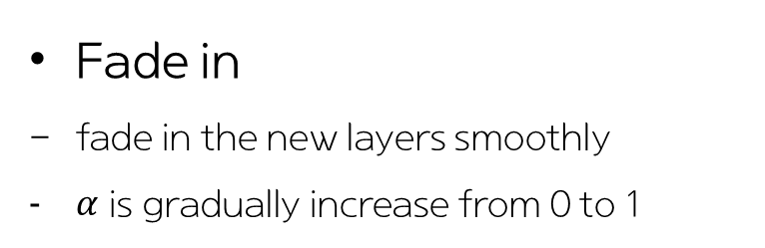
03. GAN
Progressive growing GAN (ProGAN, PGGAN)
Growing both the generator and discriminator progressively
This both speeds the training up and greatly stabilizes it.
Fade in
fade in the new layers smoothly
$α$ is gradually increase from 0 to 1

Slide 17
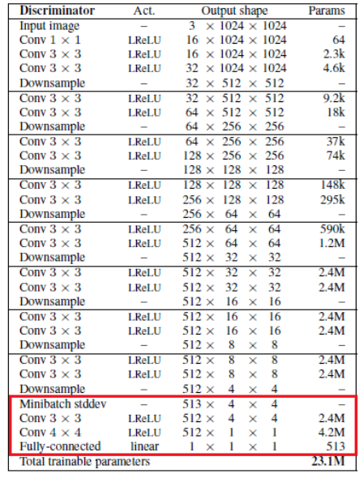
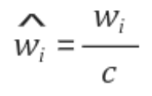
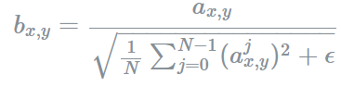
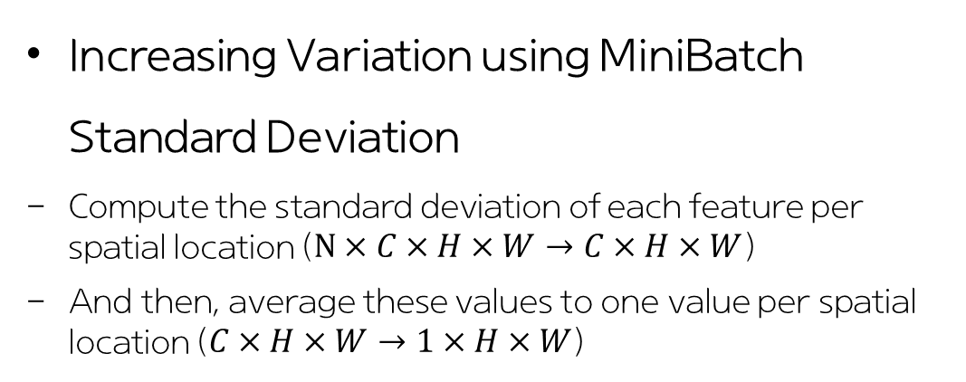
03. GAN
Progressive growing GAN (ProGAN, PGGAN)
Increasing Variation using MiniBatch Standard Deviation
Compute the standard deviation of each feature per spatial location ($N×C×H×W→C×H×W$)
And then, average these values to one value per spatial location ($C×H×W→1×H×W$)
Equalized learning rate
PixelWise Feature Vector Normalization

Slide 18
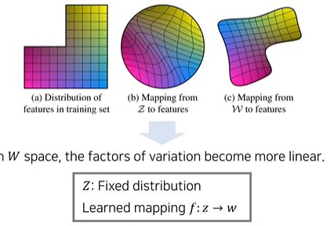
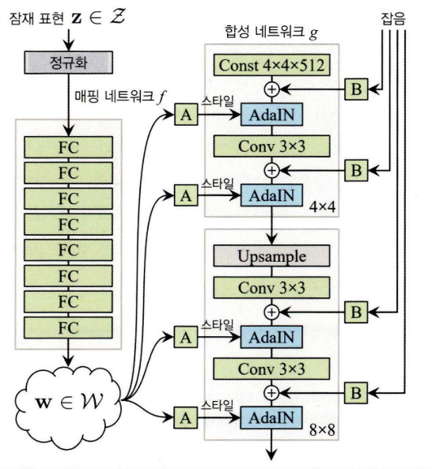
03. GAN
Mapping network
StyleGAN
: A novel GAN using style transfer method
Constant input
Use constant as input of synthesis Network
Increase performance empirically

Slide 19
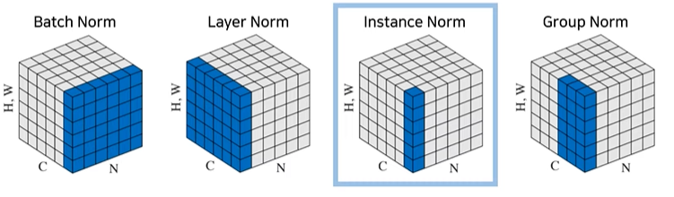
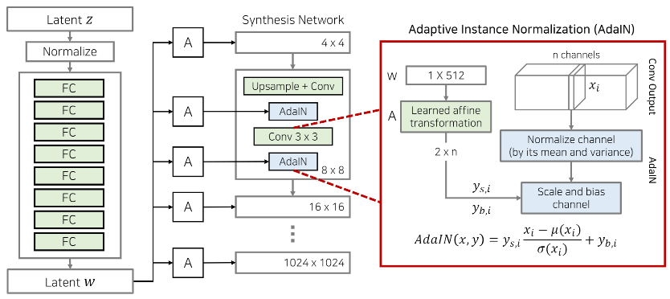
03. GAN
StyleGAN
AdaIN - Normalize each feature map

Slide 20
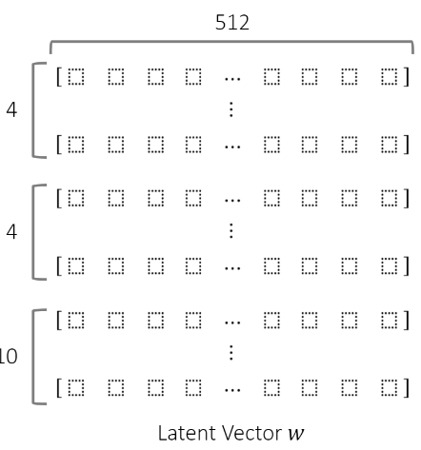
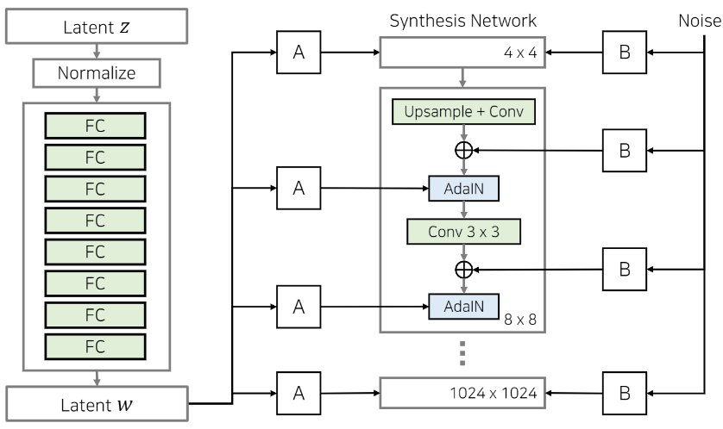
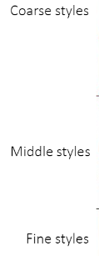
03. GAN
StyleGAN
Stochastic Variation
- Control stochastic variation like freckles and hair arrangement

Slide 21
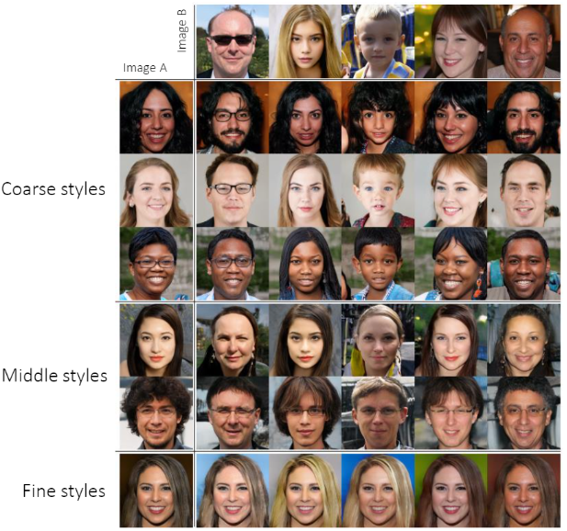
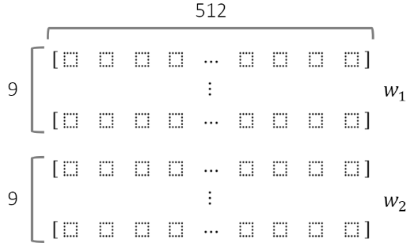
03. GAN
StyleGAN
Style Mixing (Mixing Regularization)
To reduce the correlation between adjacent layers
With two input vectors
Train some of the levels with the first and switches (in a random point) to the other to train the rest of the levels

Slide 22
Thank you

